Slide 1

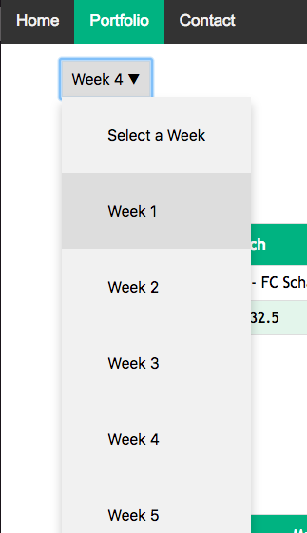
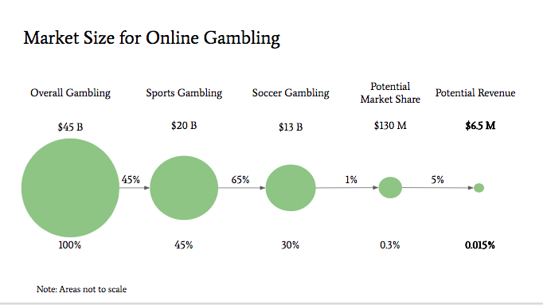
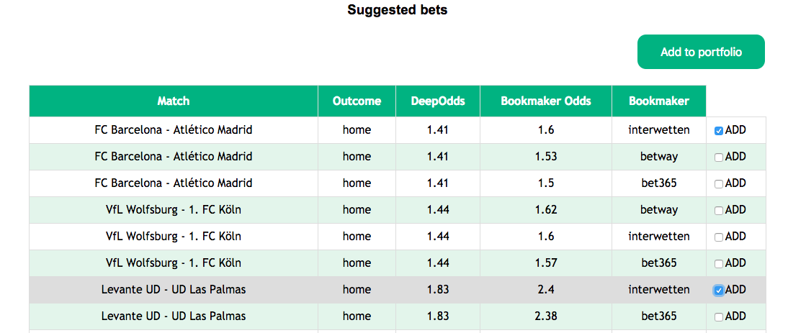
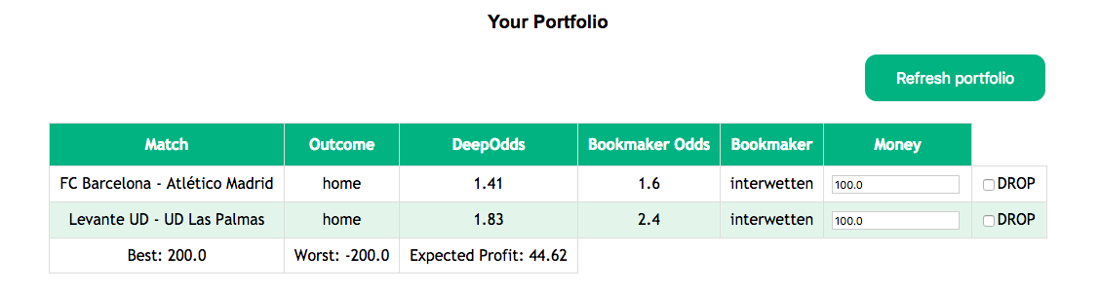

Future of Online Betting
Team Members and Roles
Current Product
Market Analysis (Pitch)
Bingyi Li
Data Scientist and Market Researcher
Responsible for understanding the statistics behind calculation of odds and doing market research
Sri Santosh Hari
Backend and Integration
Responsible for development of the backend infrastructure and integrating it with web interface
Kerem Turgutlu
Shikhar Gupta
Prince Grover
Machine Learning
Responsible for data cleaning, feature engineering, model selection and evaluation
Jose A. Rodilla
Product Manager; Web design
Responsible for frontend development, user experience and product management
The current version of our product gives best betting suggestions to logged in user for all weeks of the season
Choose the “week of season” and “League” in which the user wants to put money
Mission:
Combining machine learning and real-time odds to offer lucrative betting opportunities across multiple betting sites
Facts:
True outcome of the game only depends on teams
Bookmaker odds change dynamically depending on market and external effects
The current version predicts the winning team for whole season of 3 Premier Leagues:
La Liga, English Premier League and Bundesliga
The users have option to chose when and for which league they want to play the bet and our app will give predicted outcome of all matches during that time, sorted by most suggested match to play bet against. The users can then select a betting company in which they want to place the bet.
Once users select the matches they want to bet on, they have option to check the “expected profit” of their overall betting portfolio.
Choose the “Matches” and “Bookmaker” and add to portfolio
Our value proposition:
Unbiased and accurate odds
Real time comparison of odds against the betting houses
Intelligent recommendations for betting opportunities
Recommendations tailored to risk appetite of the user
Target Customers:
Informed bettors for soccer matches, that is, bettors who gamble habitually, follow the sport closely and aid their gambling activity by consulting stats and other sources of information
Users visiting sports and betting websites
Competition Analysis:
Betting Services:
Technologies Used
Future Extensions
Analysis done on FIFA stats data available on Kaggle
PostgreSQL use as backend database to store all FIFA data and bet suggestions
Matched betting service
Arbitrage betting
AI betting
Modeling and recommendation simulations done using Python. Utilized Pandas, Numpy, Sklearn, Flask libraries
The frontend app (website) is Flask application built on an AWS server
Real time data ingestion to predict outcomes for this year’s FIFA World Cup, Russia
Predict number of goals to be scored each team, together with final outcome
Train ”Player2Vec” that can help in team selection and lineups
Flask application for web development

